Slide 1

Session 1: Data Collection and Data Cleaning
Dr. Marta Pagnini, LSE & King’s College London
UNLOCKING QUANTITATIVE HISTORICAL TEXT DATA: FROM THE ARCHIVES TO ANALYSIS

Slide 2
Let’s get to know each other ☺
Introductions: name, where are you from, PhD year, your research interests, what would you like to learn in this course, anything you want to share
Notes:
10-15 minutes

Slide 3
About me and my research
Hello! I am Marta!
Studied IR in Pisa, then Sociology in Paris-IV Sorbonne, and studied at the LSE ever since for MSc and PhD
Sociology of elites: how do elite actors survive over time/navigate social change? Research interests in old/traditional elite actors
Focus of the PhD was the British monarchy, and collaborative research focused on economic elites (forthcoming SER) and on elite academic institutions (networks of the British Academy, 1904 – 1919, with Mike Savage, submitted in EHR)
Future research interests: British aristocracy and land inequality
Notes:
5 minutes

Slide 4
MY PHD research
Thesis title: “The Royal Touch: Consecration, Self-legitimation and Nation-Building in Royal Events, 1870 – 1949”
The survival of the monarchy in the 21st century Britain is the most puzzling ‘older’ form of power
How is it possible that in a society legitimised by equality and merit, the monarchy, based on the opposite principles of privilege and inheritance, continues to survive, remaining a central institution at the heart of the British state?
Studying royals’ behaviour over time provides an example of how elite institutions navigate social change in a period that increasingly questions the legitimacy of its hereditary power

Slide 5
data
Data-driven approach: I was interested in relational data, in elites, in power structures in a Padgett and Ansell (1993), and then randomly found the Court Circular
Historical archival quantitative research to uncover the behavioural shifts of the British royal family in the 19th and 20th century: who they interacted with, where, in what capacity for 80 years of British years
Court Circular: official record of royal engagements, authorized daily by the British monarch, and published daily in The Times from 1803 to today, and since 1997 in the official website of the royal family at https://www.royal.uk/media-centre/court-circulars

Slide 6
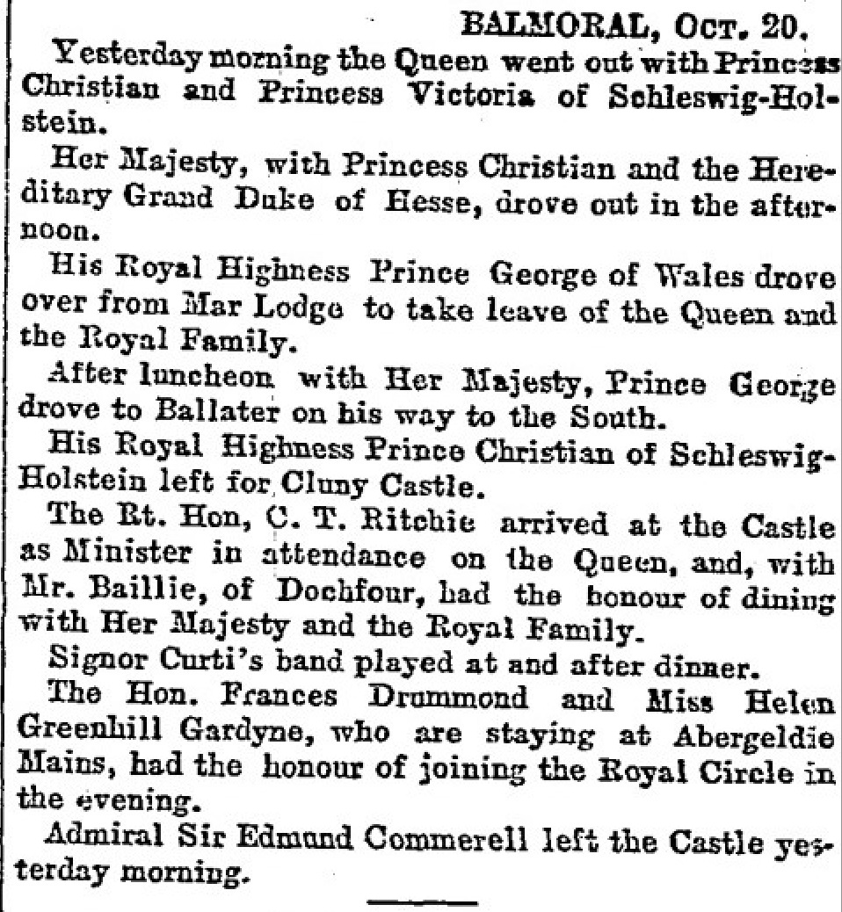
Data
Court Circular (1870– 1949): Official agenda of activities of the British royal family (1803 –2020) published daily on The Times, The Telegraph and The Scotsmen (Royal Household 2020). Type of activities: receptions, visits to organizations, visits to locations, investiture ceremonies, attending cultural events, board meeting at companies, state banquets.
Notes:
However, there is no empirical data emphasizing the role that the monarchy played in sustaining this recent and heterogenous union. I show empirically that what the monarchy consecrated was instead an Anglo-centred nation, which it symbolically sustained through its disproportionate visits to England.

Slide 7
methods
Web-scraped over 23k images of the Court Circular from the Times (1870 – 1949)
Extracted names of individuals (over 300,000 non-royal individuals) and locations (over 150,000 UK locations) from the Court Circular with NLP models
Explore who royals met (e.g. aristocrats, clergymen, public officials)
Where they went, and namely the locations they went to
In what capacity, by looking at the type of events they participated in
Whether participating in these events had any consequences for the lives of aristocrats in terms of career mobility or title mobility

Slide 8
course plan
Session 1: Data collection methods to gather historical archival data, with a focus of web-scraping, OCR techniques, and data cleaning (making sure that the architecture of the dataset is solid!)
Session 2: Information extraction methods. We will use regular expressions and named entity recognition (NER) models to extract names of individuals from the Court Circular. However, with the same method you could extract other entities from various corpora, such as names of organizations or locations!
Session 3: This session covers how to categorize information using text classification models. Once we extract the names of individuals, how can we categorize them for our analysis? The session concludes with an example of transforming spatial information into map-ready data, linking locations to country, region, and county levels.
Any questions?
Notes:
A flavour of what I did, and how it could inspire your own projects. Doing archival work.

Slide 9
R AND PYcharm
If you haven’t already done it, please install:
R: https://cran.r-project.org/
R studio: https://posit.co/download/rstudio-desktop/
Pycharm: https://www.jetbrains.com/pycharm/download/?section=mac
If you have installed them, please help your peers going through the installation ☺
All the material for the course in on Github: https://github.com/Marta2124/Unlocking-Quantitative-Historical-Text-Data-From-the-Archives-to-Analysis-University-of-Florence.git
To clone the material, open your terminal and write:
cd ”your working directory”
git clone https://github.com/Marta2124/Unlocking-Quantitative-Historical-Text-Data-From-the-Archives-to-Analysis-University-of-Florence.git
Notes:
We need these different software because quite advanced, r not very good for some of it

Slide 10

Data collection
Newspapers as a source of historical longitudinal data
Official records: official gazettes, cadastre
Historical archives of organizations: British Academy nomination data, data on club membership (Noble 2025).
What are the pros and cons?

Slide 11
Pros of collecting newspaper data
Easier access than private archive
Continuity over time
Use of digital archives (if accessible)
The Times:
- Factiva: from 1980 onwards
- Gale Times Digital Archives (1785 to 2019)
- https://www.royal.uk/media-centre/court-circulars (1997 - today)

Slide 12
WEB-SCRAPING
Does anyone know what web-scraping is?

Slide 13
WEB-SCRAPING
Does anyone know what web-scraping is? Has anyone used it?
“The process of extracting and combining contents of interest from the Web in a systematic way. In such a process, a software agent, also known as Web robot, mimics the browsing interaction between the Web servers and the human in conventional Web traversal. Step by step, the robot accesses as many Web sites as needed, parses their contents to find and extract data of interest and structures those contents as desired.” (Glez-Peña et al 2014)
Need to be very careful! Grey area. Infringement of copyright, privacy laws (e.g. scraping private page like Instagram)
Only use for public data
Notes:
Cambridge dictionary: Traversal is the process of visiting each node in a data structure, and performing some action.

Slide 14
Web-scraping the Court Circular
clicked ‘advanced search’
wrote ‘Court Circular’ in the ‘Terms’ section
selected ‘Document Title’ in the ‘Field’
Under the ‘Publication date(s)’ section, I specified the time interval during which the Court Circular was published
The advanced search then resulted in a list of hyperlinks named Court Circular (in blue), and by clicking each of them I could access the Court Circular from a specific day (Figure 3.4).
After clicking the blue hyperlink named ‘Court Circular’, the website redirected me to specific images of the Court Circular.
Notes:
https://www.gale.com, access through your institution
Show the inspect

Slide 15
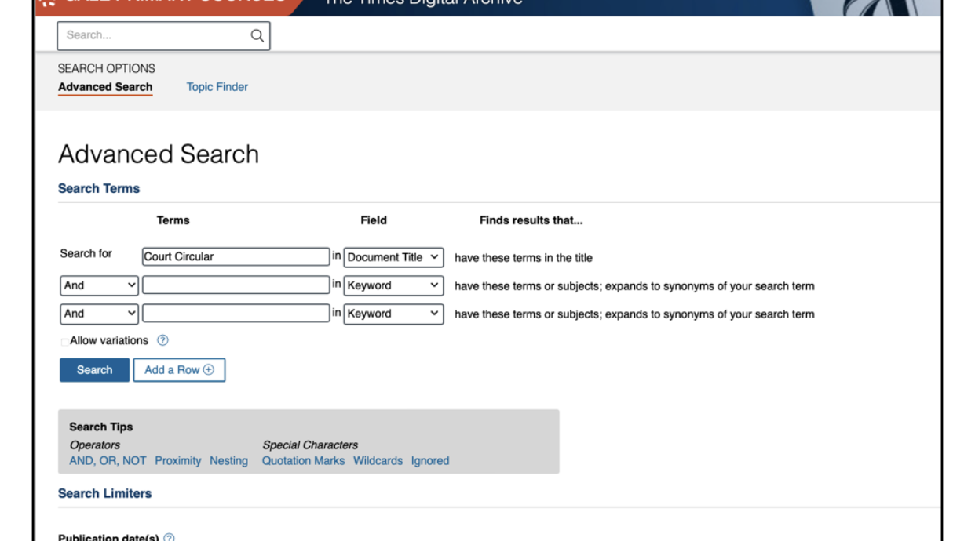

Slide 16
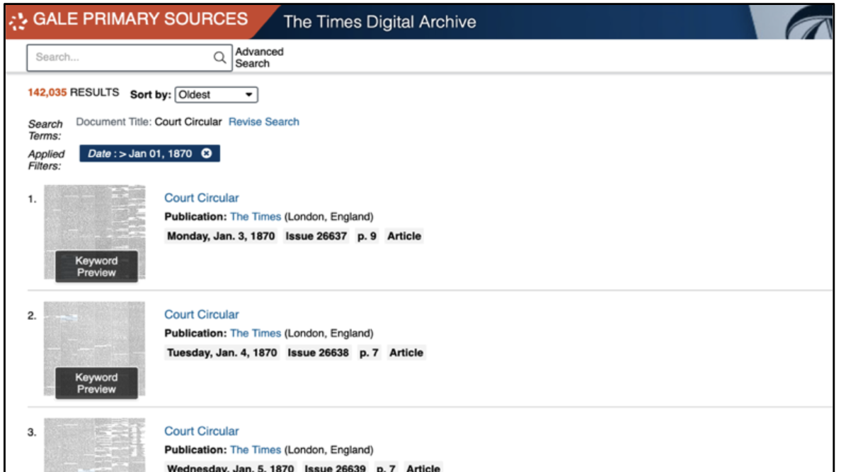

Slide 17
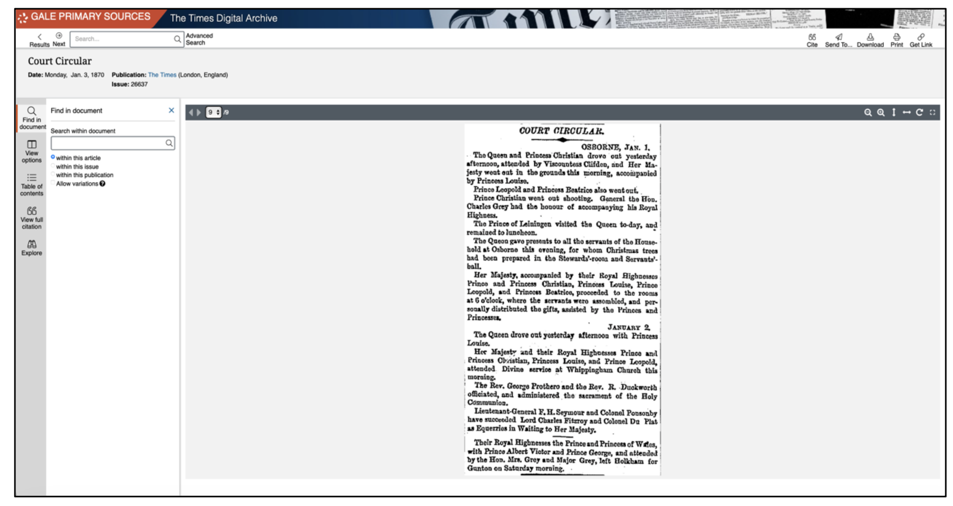

Slide 18
The case study of the Library of Congress
API
https://libraryofcongress.github.io/data-exploration/loc.gov%20JSON%20API/Chronicling_America/README.html

Slide 19
Transformation of images into text with ocr and text segmentation: the case of the court circular
Issues with in-built OCR algorithms in digital archives. I run tests to check which OCR worked best, including Tesseract (in R), and Google Vision.
Built a model to distinguish between events and non-events (we will see how to run similar models tomorrow)
How do I get events? Any ideas? Try to think about strategies for 5 – 10 minutes

Slide 20
Transformation of images into text with ocr and text segmentation: the case of the court circular
Issues with in-built OCR algorithms in digital archives. I run tests to check which OCR worked best, including Tesseract (in R), and Google Vision.
Built a model to distinguish between events and non-events (we will see how to run similar models tomorrow)
How do I get events? Any ideas? Try to think about strategies for 5 – 10 minutes
Use of Google Vision document_text function that segments text into existing paragraphs

Slide 21
references
Daniel Glez-Peña, Anália Lourenço, Hugo López-Fernández, Miguel Reboiro-Jato, Florentino Fdez-Riverola, Web scraping technologies in an API world, Briefings in Bioinformatics, Volume 15, Issue 5, September 2014, Pages 788–797, https://doi.org/10.1093/bib/bbt026
Marta Pagnini, 2025, Chapter 3: Methodological Reflections in: The Royal Touch: Consecration, Self-Legitimation, and Nation-Building in Royal Events.

